Slide 1
VAST Challenge 2017 MC1
Second progress presentation
Team Members: Hriday Mistry, Karan Narad, Ryan Hare, Luobin Cui, Tarun Teja Kairamkonda
Reporters: Ryan Hare, Tarun Teja Kairamkonda

Slide 2
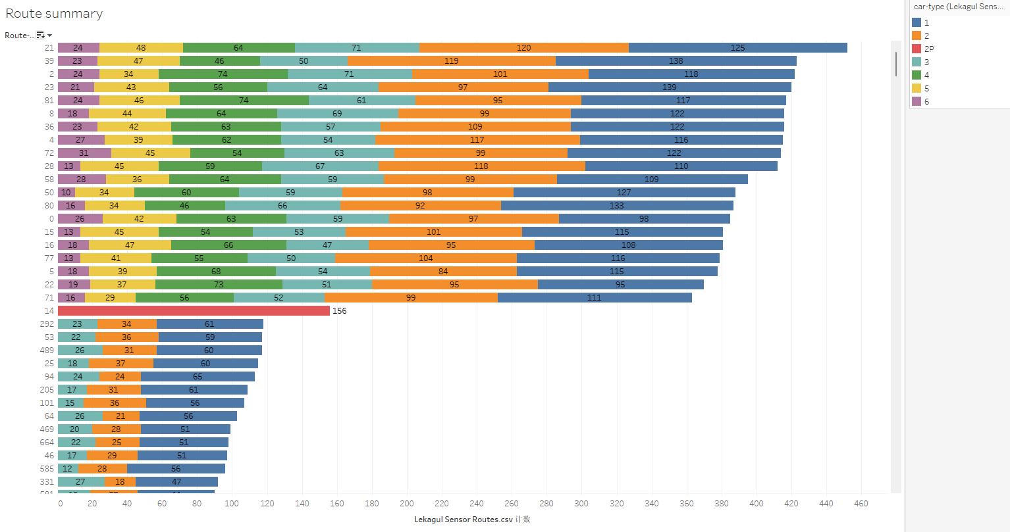
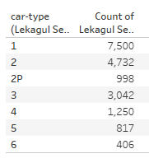
Route part
18,745 routes

Slide 3
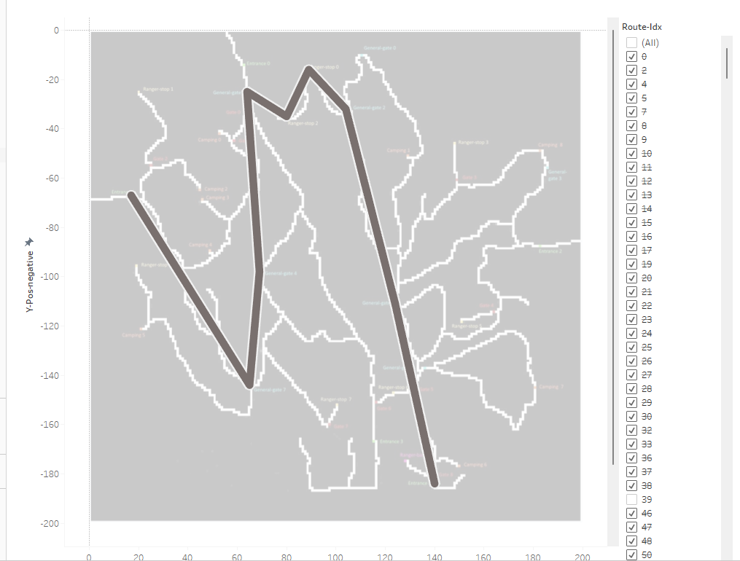
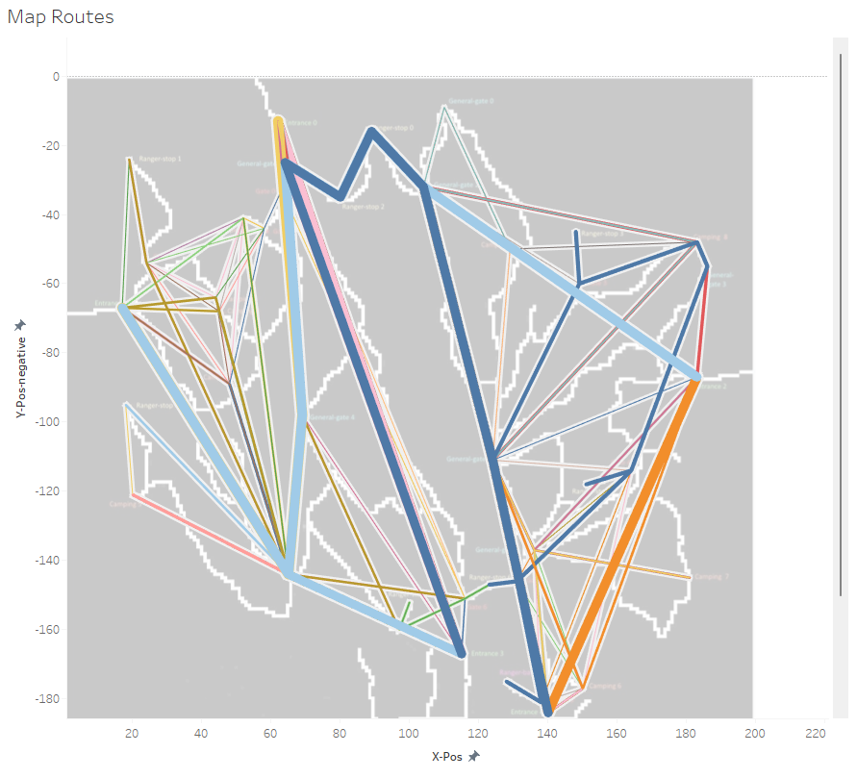
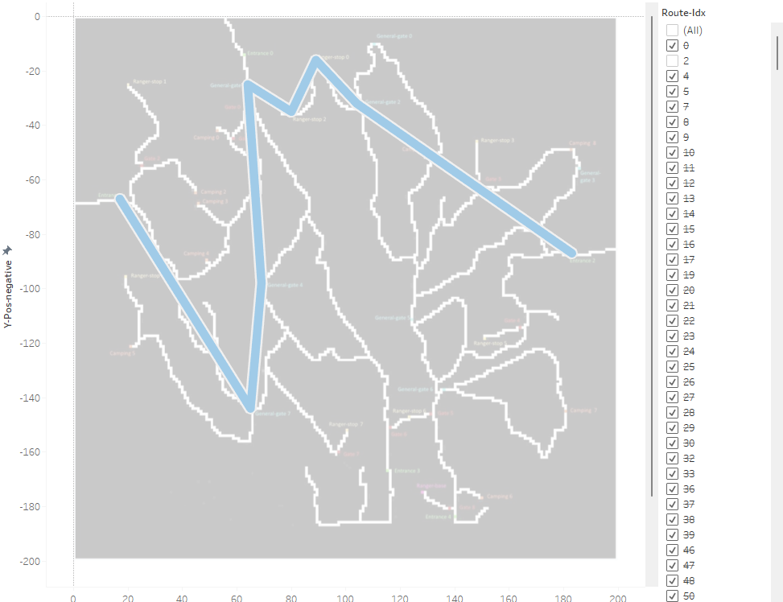
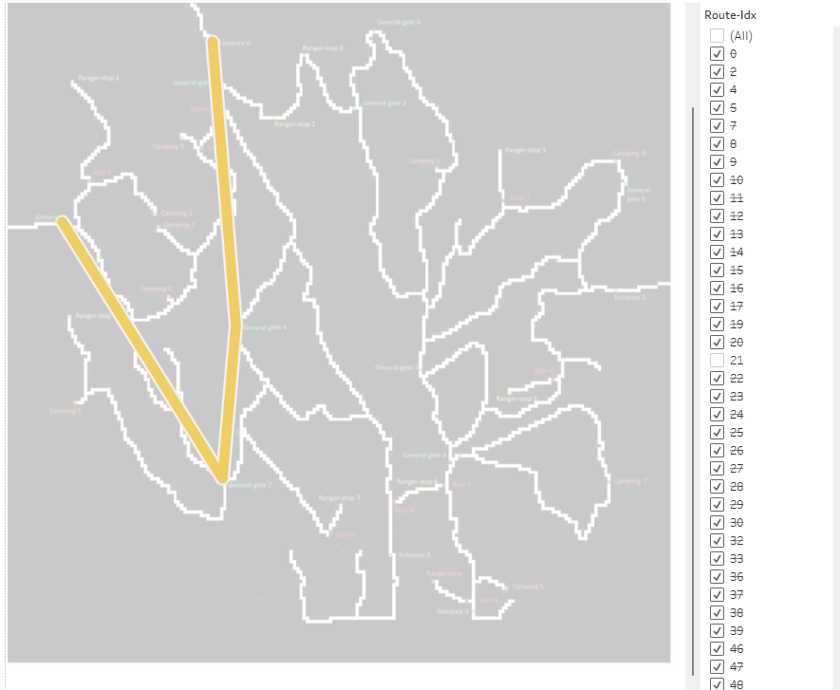
route 21
route 2
route 39

Slide 4
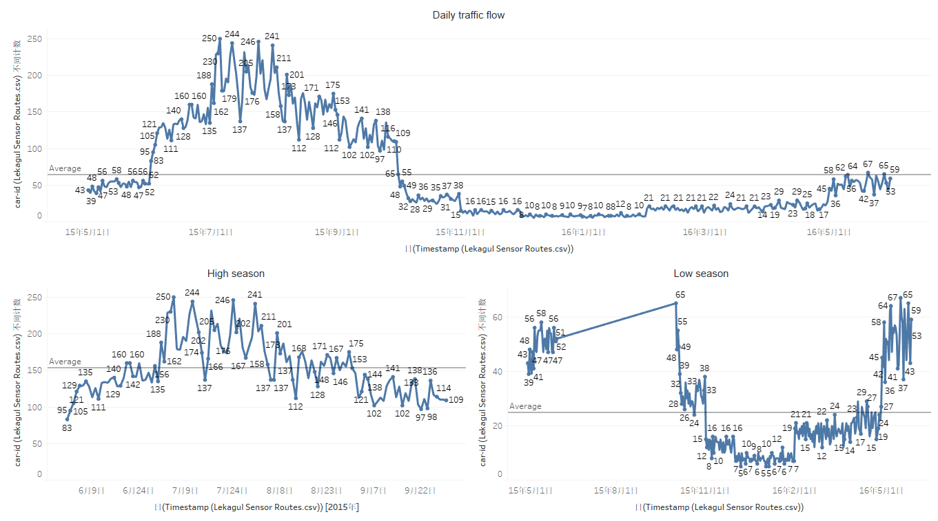
15-7-5
Notes:
High season 6~9 Low season10~5

Slide 5
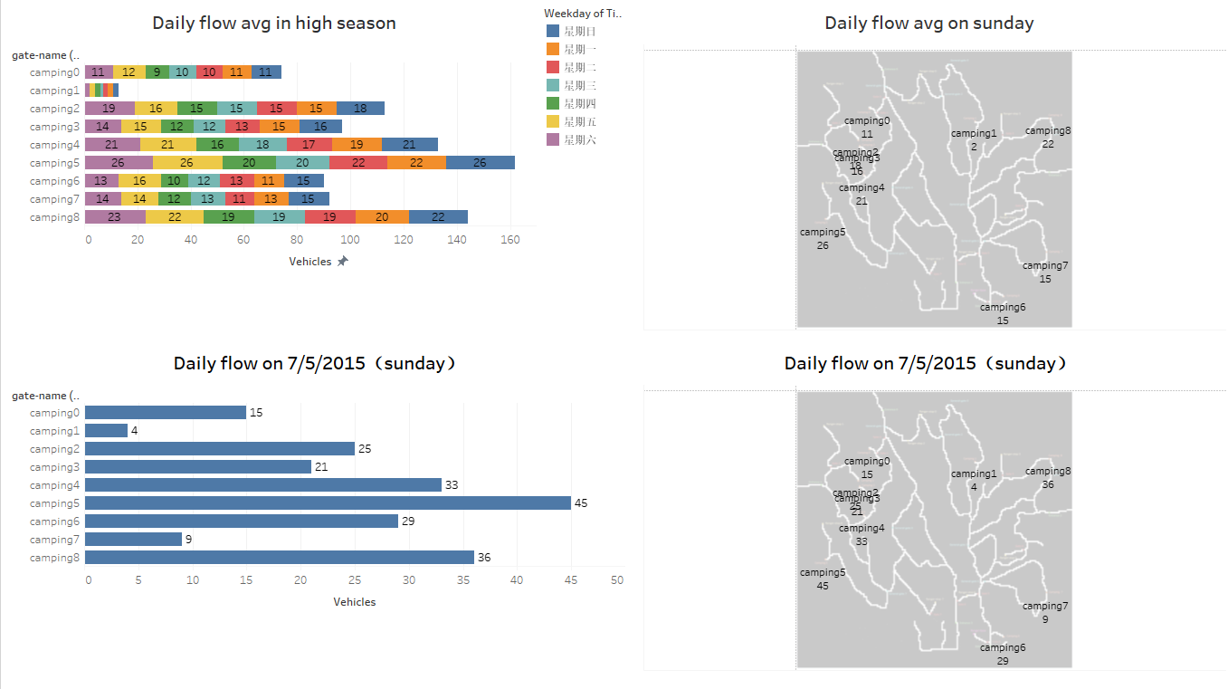
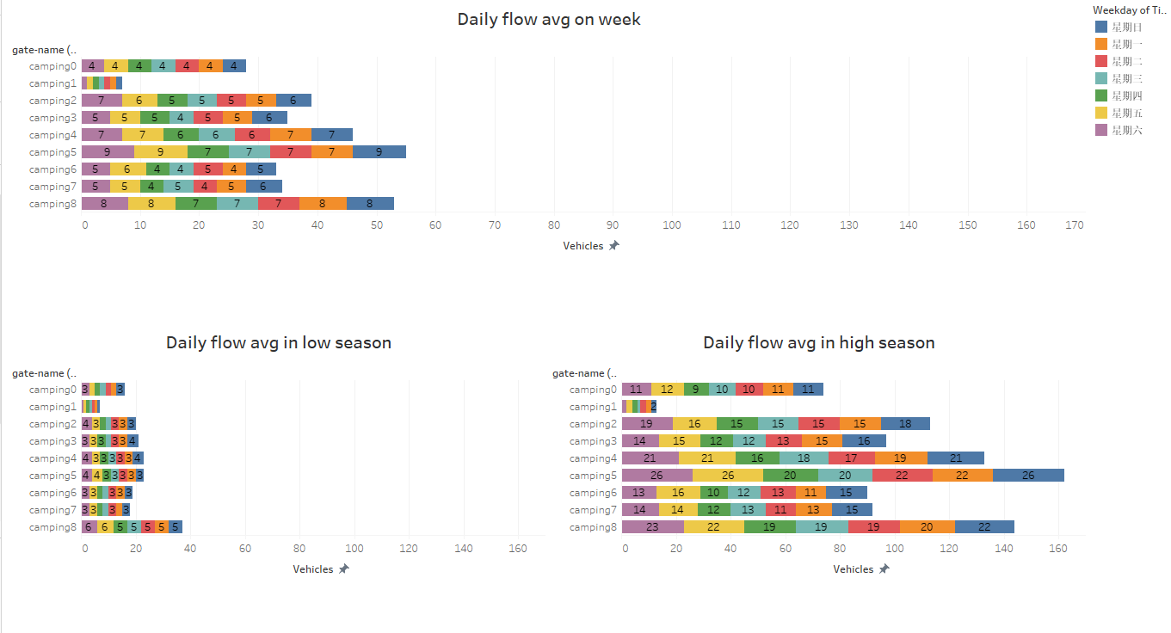
Notes:
camping5 have

Slide 6
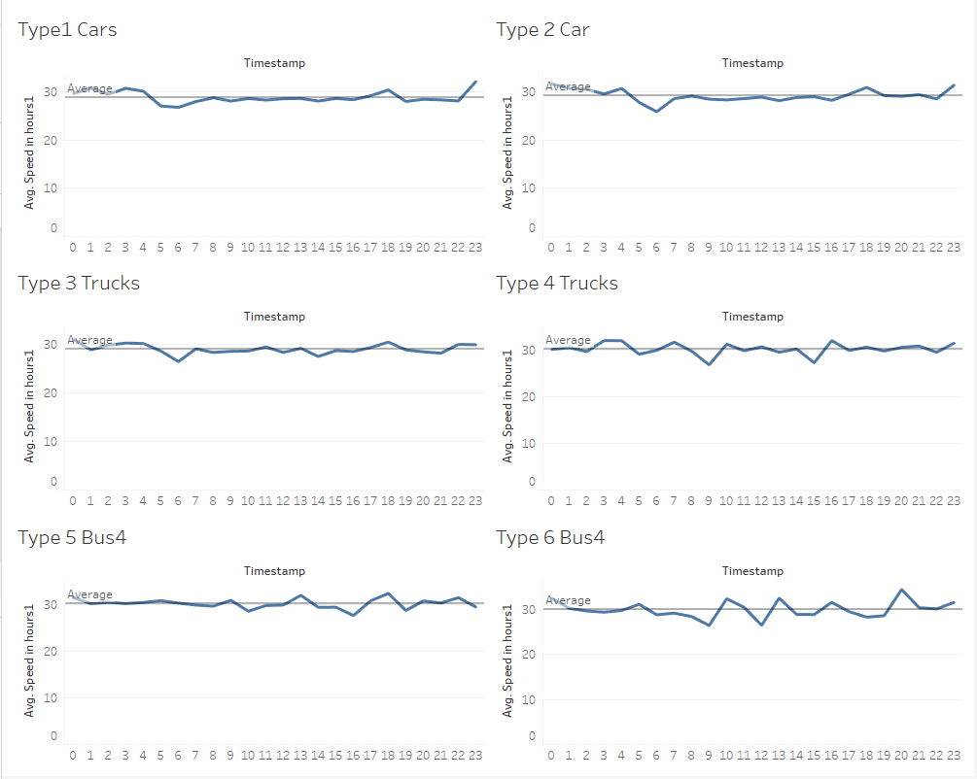
Daily speed patterns of various types of vehicles

Slide 7
Unusual Patterns

Slide 8
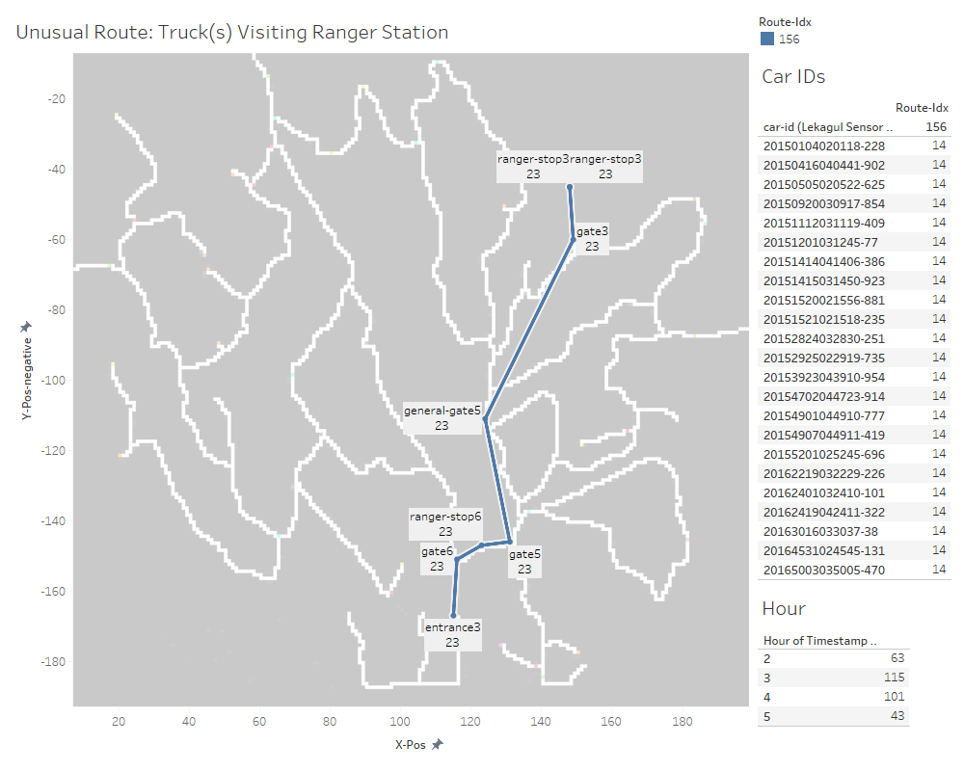
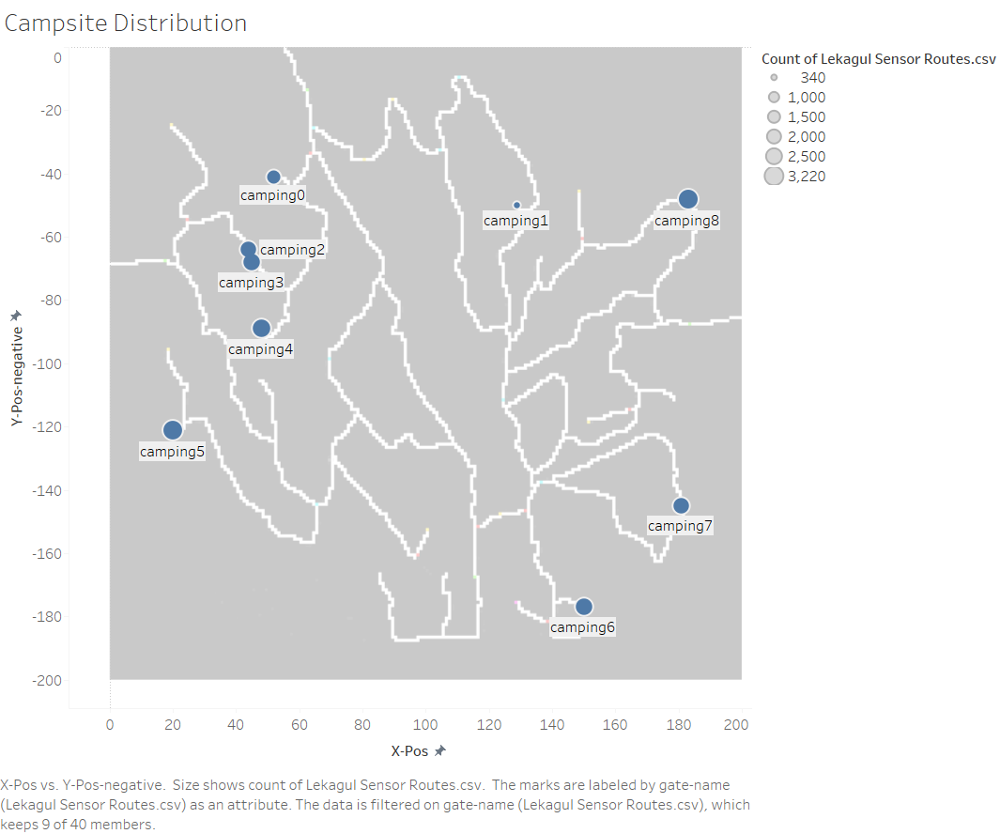

Slide 9
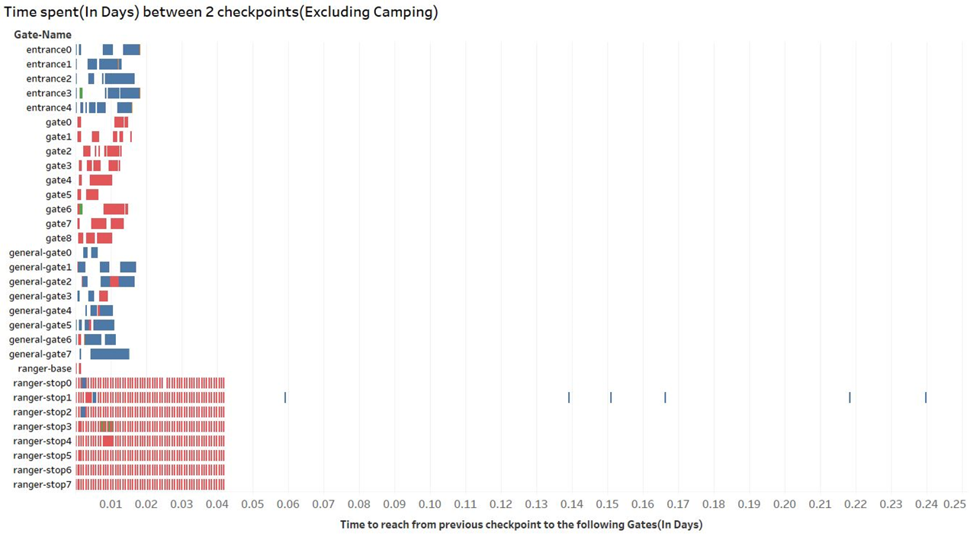
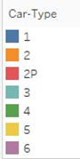
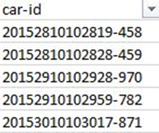
No cars were observed staying more than 6 hours between 2 checkpoints(Excluding camping data).
We can observe some type-1 cars take some time before they reach a ranger stop, quite possibly because the car might have faced some trouble or the rangers wanted to question the driver(s) for suspicious activity.
Those car Ids can be observed in the lower right image.

Slide 10
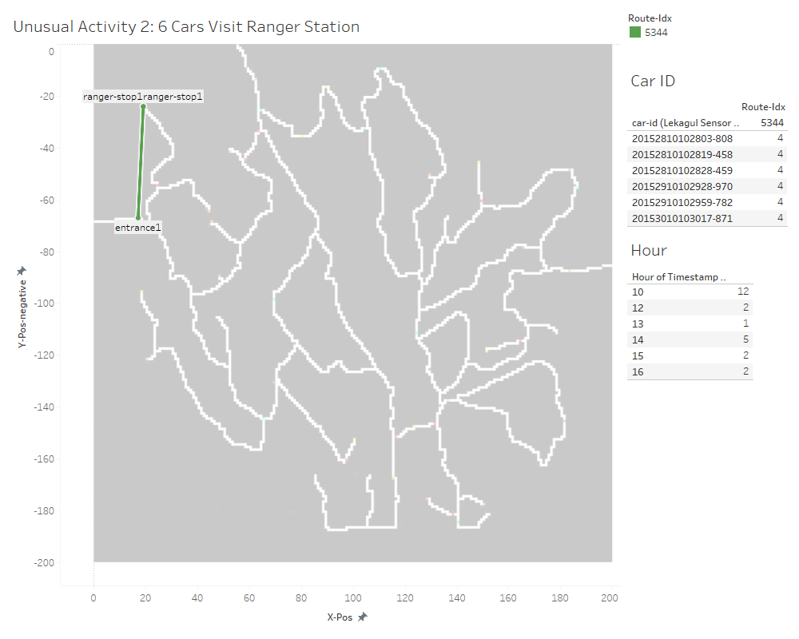

Slide 11
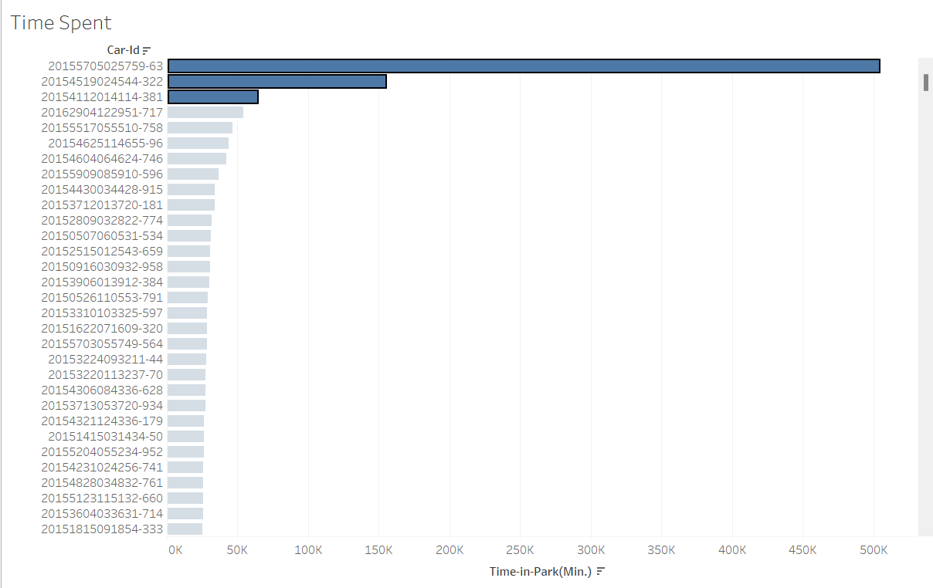
Unusual Patterns

Slide 12
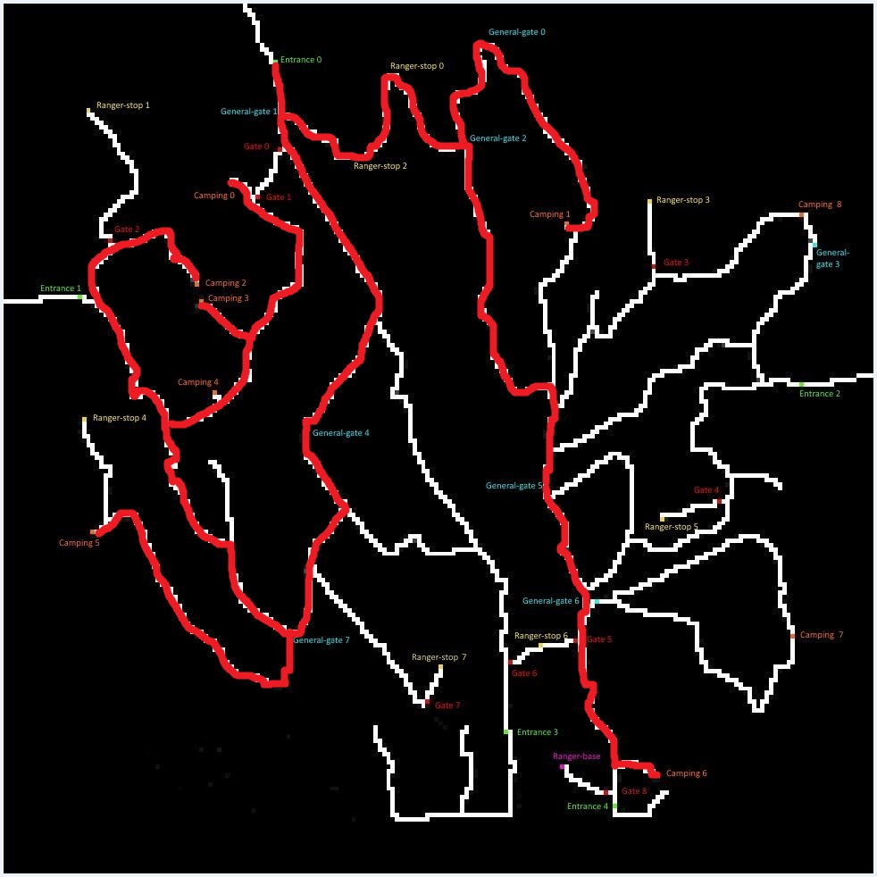
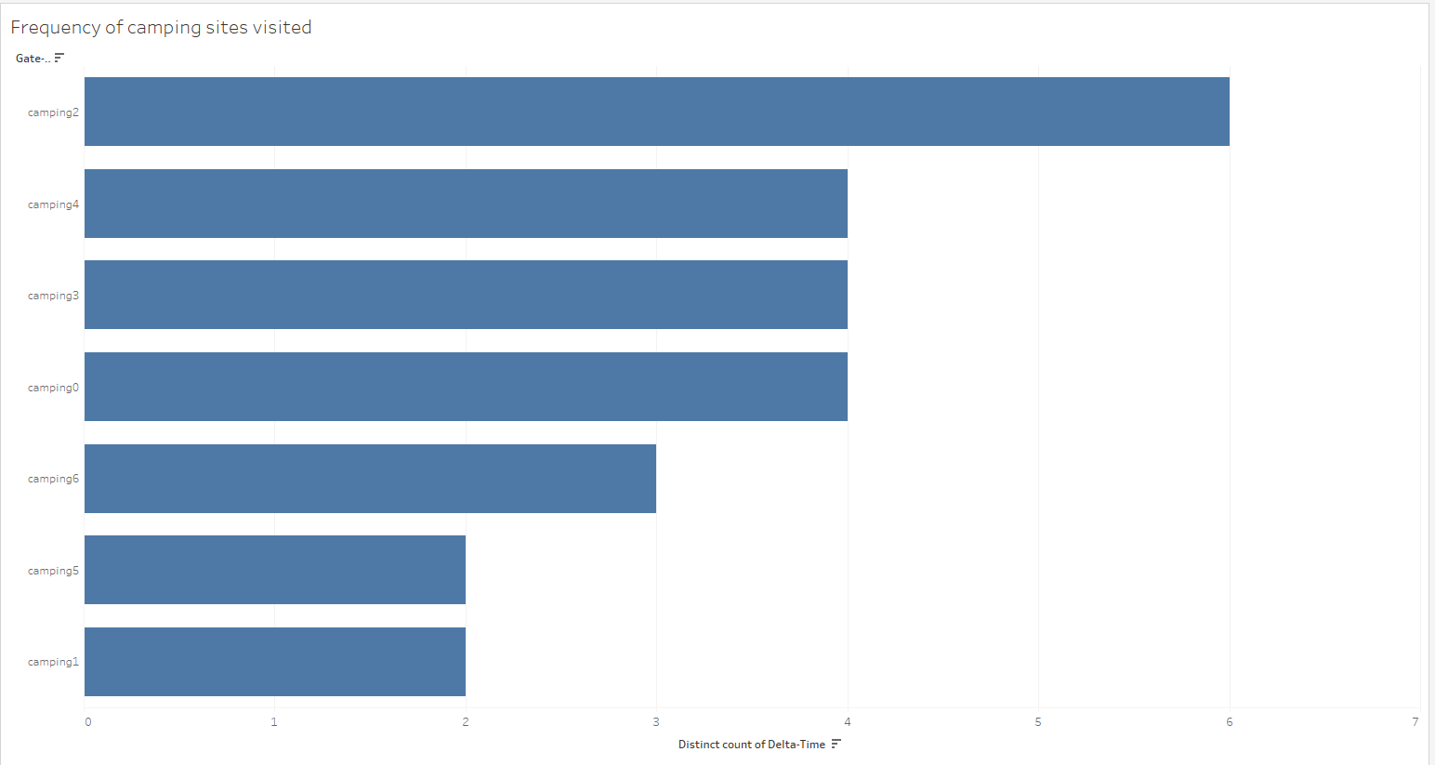
For Car-Id: 759-63
From our data we observed that the car never exited the park.
Also, it never visited camping site 7 & 8.

Slide 13
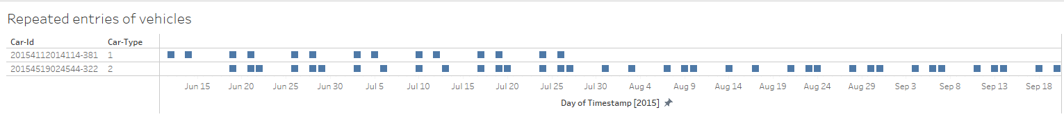
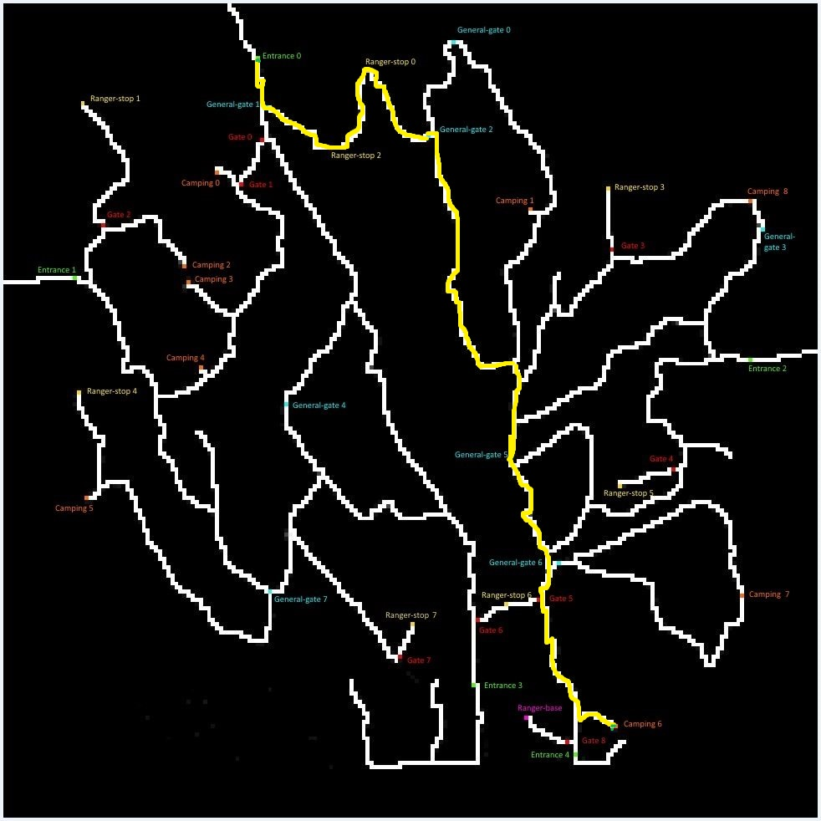
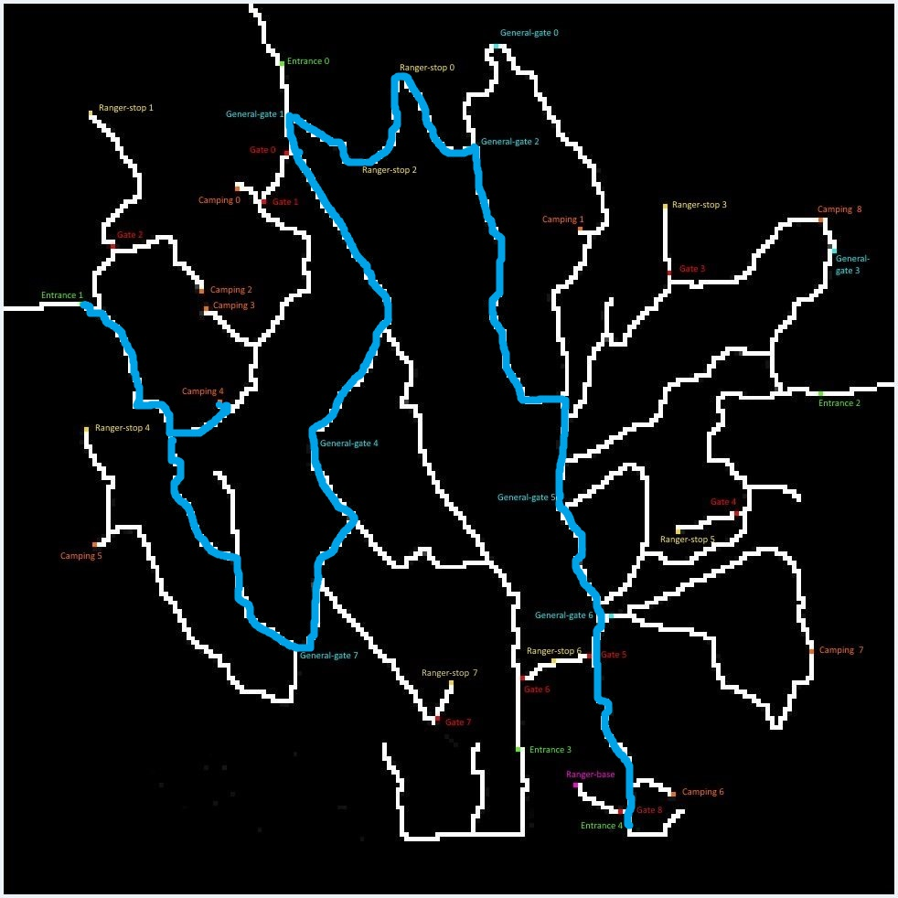
Unusual Patterns
114-381
544-322

Slide 14
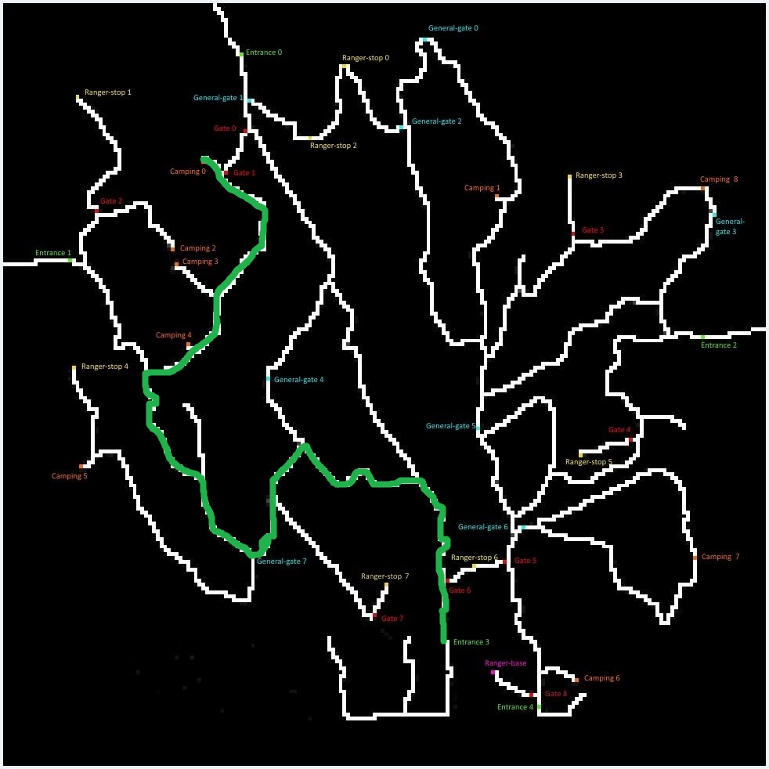
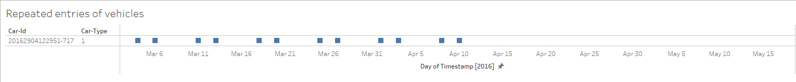

Slide 15
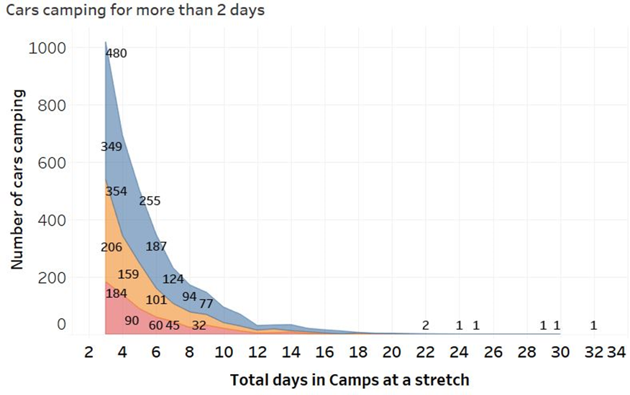
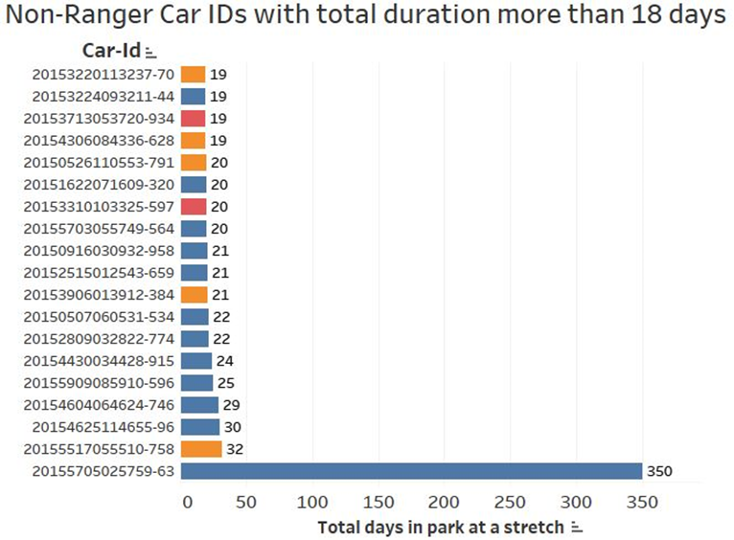
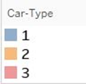
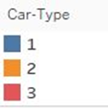
Staying at the reserve for long durations might be a burden to the bird’s natural habitat and quite possibly one of the main reasons for the reduction of the population of Rose-Crested Blue Pipit.
Below are the cars that stay in the park for very long durations.
This data excludes the ranger cars.
There are cars that can be seen staying in the park for up to 32 days.
There is one type-1 car that has never left the reserve and has stayed in the park for over 350 days.
Graph depicts the cars staying at camp sites for more than 2 days.
Only car type 1,2 and 3 stay at the camps for such long durations.
Some cars can be seen camping for as long as 22 to 32 days.

Slide 16
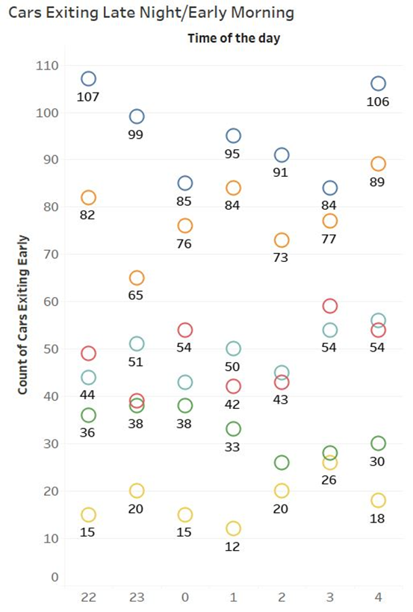
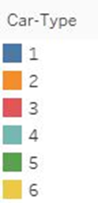
Car activity during the night might adversely affect the Rose-Crested Blue Pipit’s habitat and such disturbances might lead to the migration of the birds from the Nature Preserve.
This graph represents the cars that exit the Nature Preserve between 10PM and 5AM and have stayed in the preserve for less than 4 hours total.
This might be a concern for suspicious activity or these might be the cars that have been using the Nature Preserve as a short-cut.

Slide 17
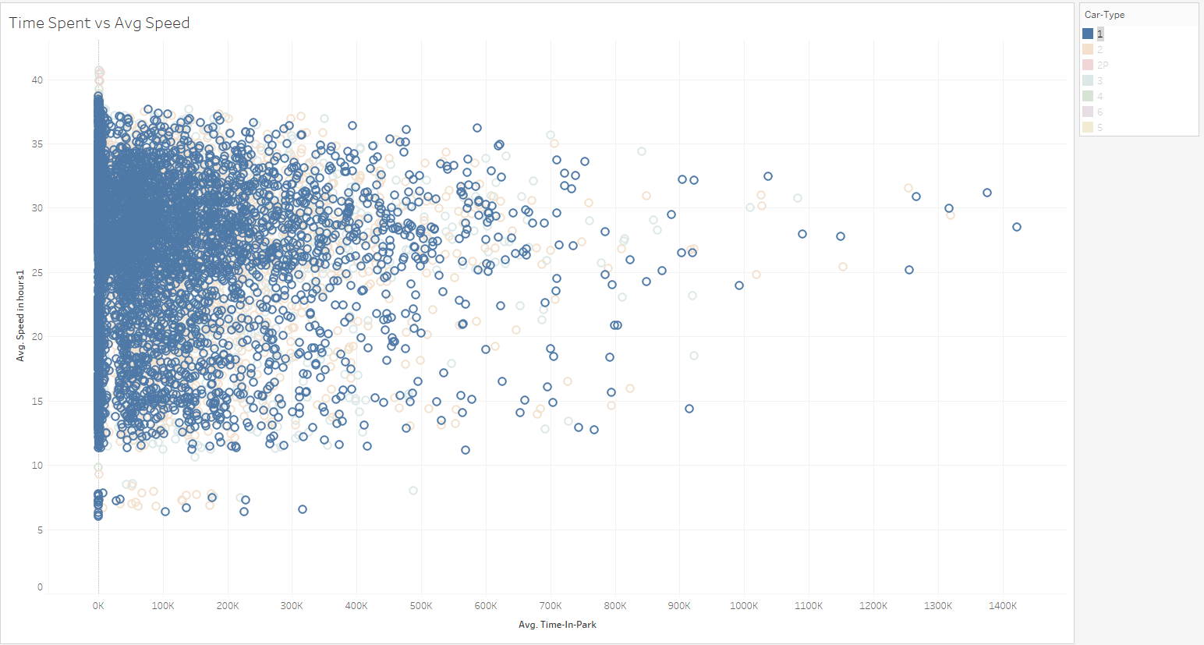
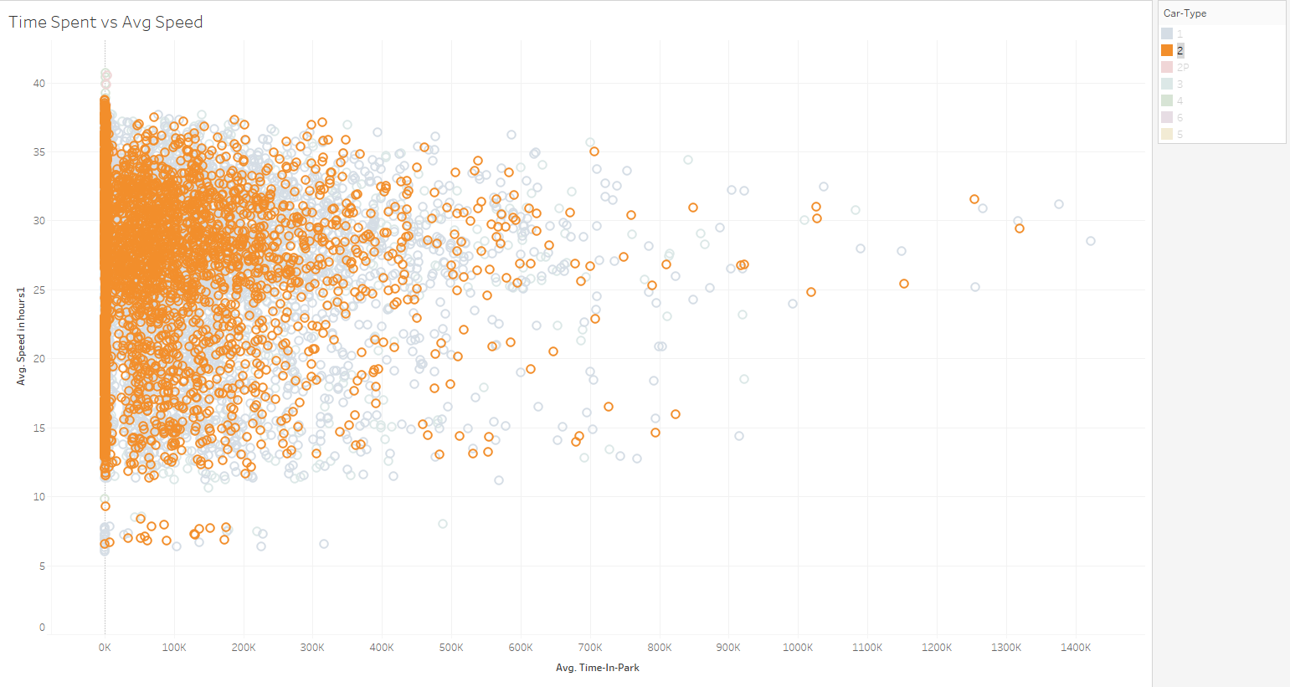
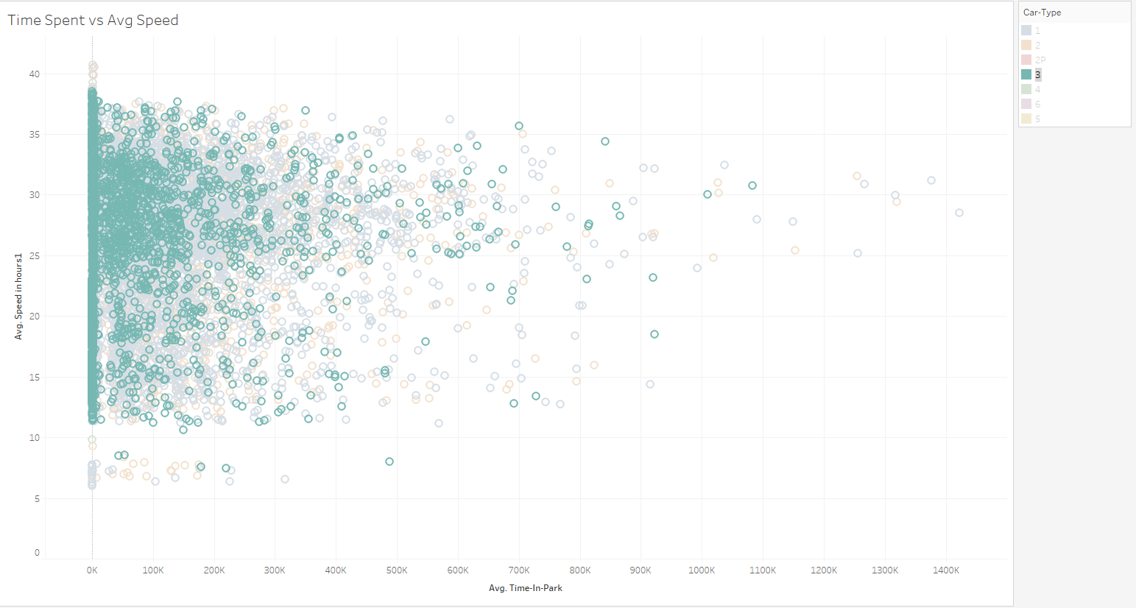
Time spent vs Avg speed
We can see two clusters of vehicles, who are site viewers who go very slow and others are spread over various speeds and time spent in park.

Slide 18
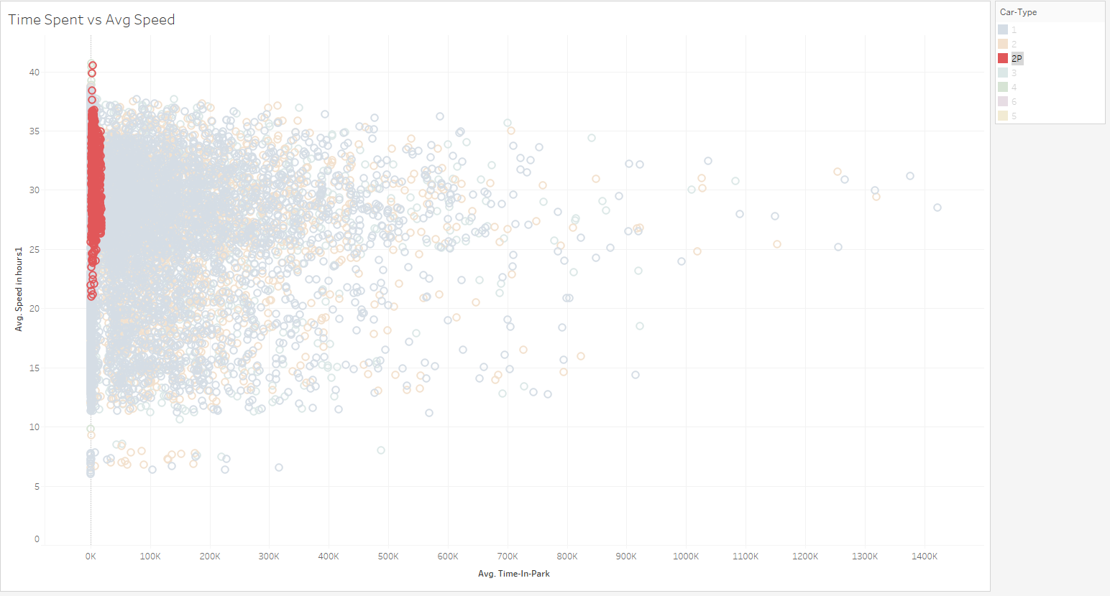
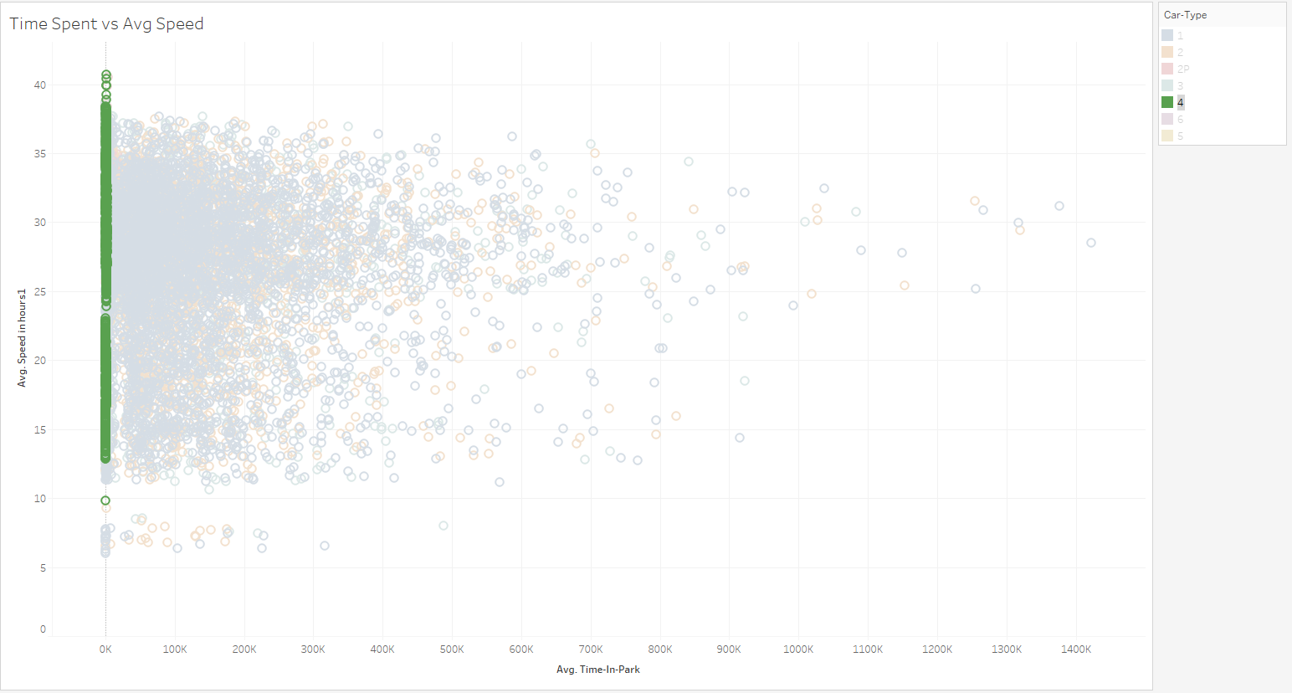
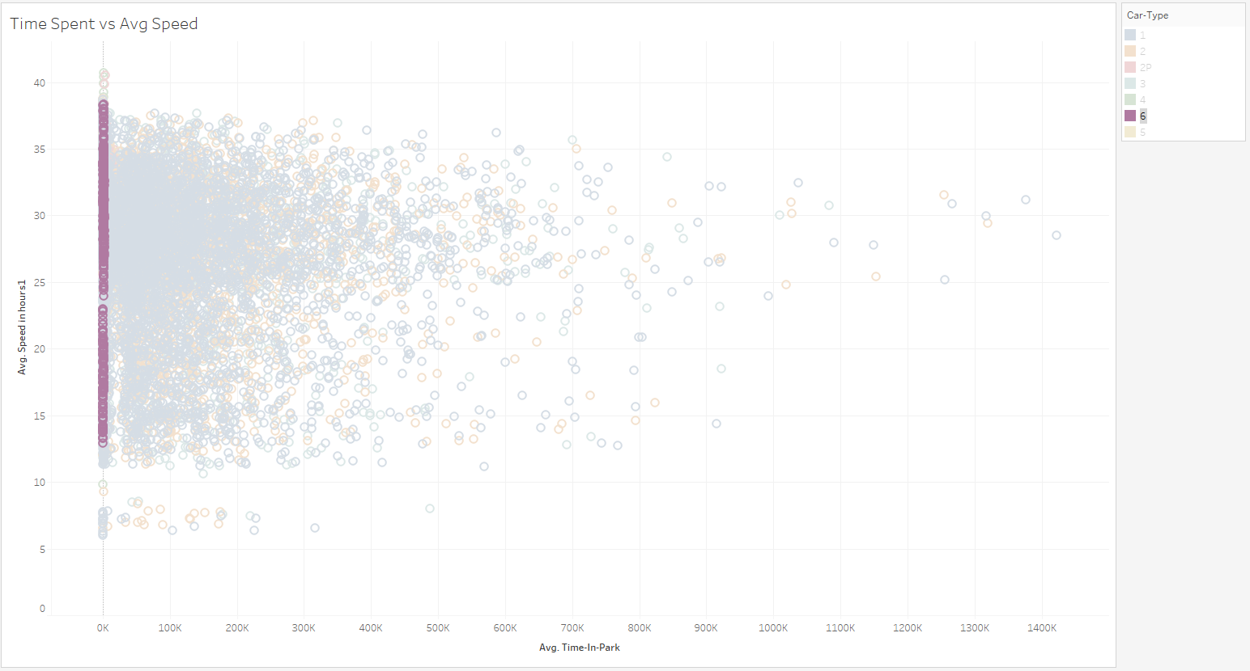
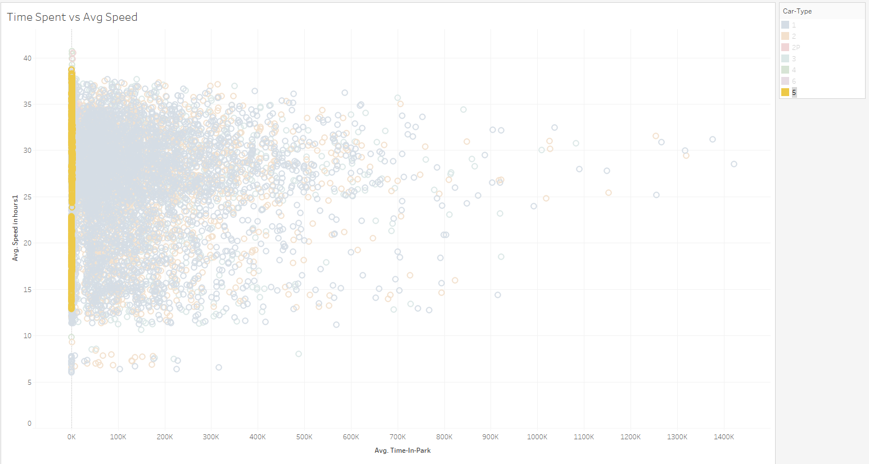
Time spent vs Avg speed

Slide 19
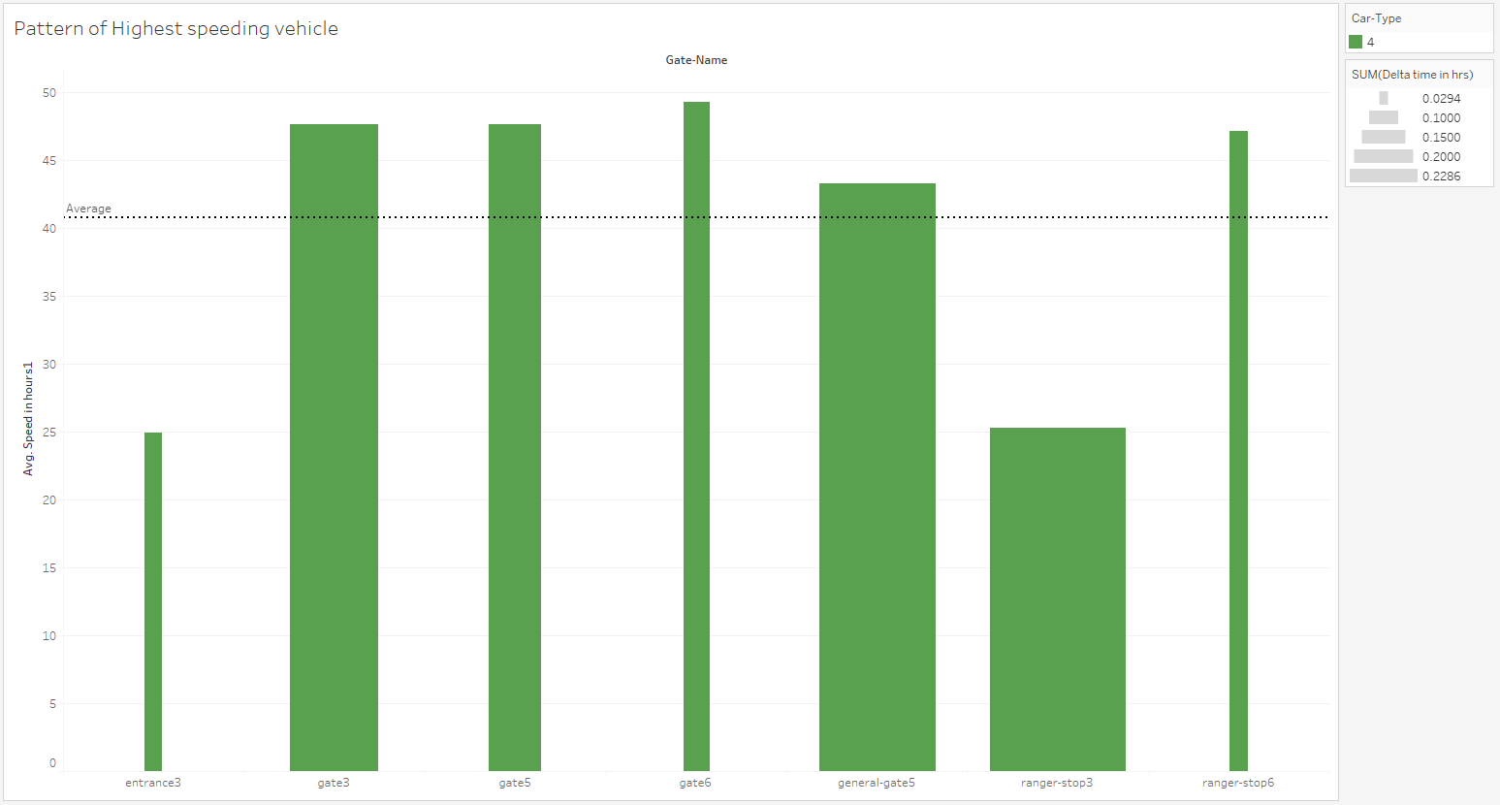
Speed Patterns of Highest Speed Vehicle

Slide 20
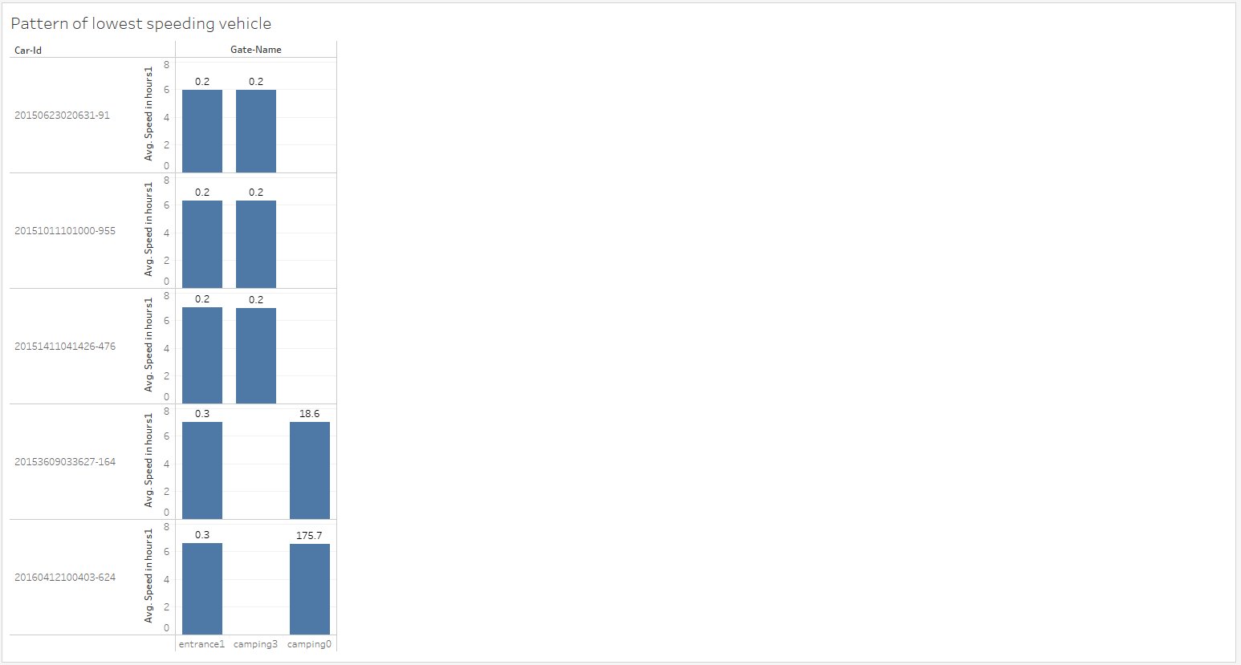
Speed Patterns of lowest Speed Vehicle

Slide 21
Contributions
Data Exploration, Preprocessing for Speed, Unusual Patterns:
Hriday Mistry: Slides 6,11-14,17-20
Karan Narad: Slides:9,14-16
Tarun Teja Kairamkonda: Slides 6,11-14,17-20
Preprocessing for Routes, Unusual routes:
Ryan Hare: Slides 8, 10, and first image on slide 3
Luobin Cui: Slides 2-5

